Slide 1
License Plate Recognition using Raspberry Pi & Tesseract OCR Engine
Project Graphics
By:
Wei Kit Wong, Daemon Macklin,
Joseph Rodrigues, Yu Zhang

Slide 2
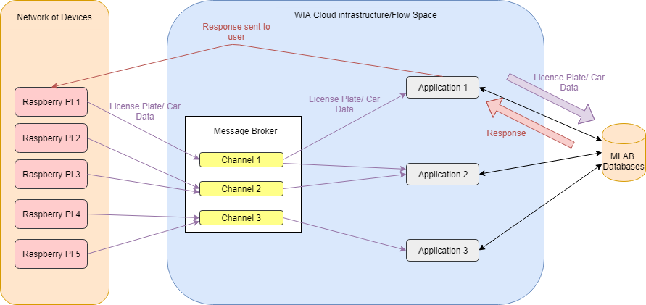
Block Diagram of Overall System
The System will operate with 3 main stages. The local system titled “Raspberry Pi”. The message broker and the application hosted on WIA. Lastly the database. Once an image is taken from the pi and a license plate can be read the license plate data is sent to the message broker. The data is sent to the channels that the local system is subscribed to. The data is sent through the channel to the application or applications that are listening to that channel. The application will take the data and check it against their database. The database will send to response to the application. The response will depend on what the application is for. For example, if the application is for the police the database will return data on the car and what if any reasons for the car to be pulled over. When the response is sent to the application, depending on the application the it might send a response to the local system via SMS. In the police application this would be the data on the car that needs to be pulled over. Other applications might not send responses but record the data from the local system.

Slide 3
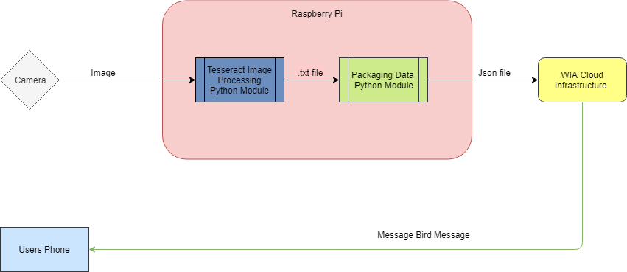
Flowchart of Local System
The local system is made of two key components the camera and the PI. The camera is connected directly into the PI. When an image is taken the image is sent to the PI. Using Tesseract OCR the license plate is extracted from the image. The license plate from the image is output to a .txt file and sent to the next python module. The license plate data is packaged in a Json file along with location information, the channels the local system is subscribed to and other data that might be needed. The Json file is then sent to the Cloud infrastructure. If the application the system is using needs to send a response the response is sent from the application containing the information such as the information on a car that needs to be pulled over is sent to the users phone using message bird which is a SMS service built into WIA

Slide 4
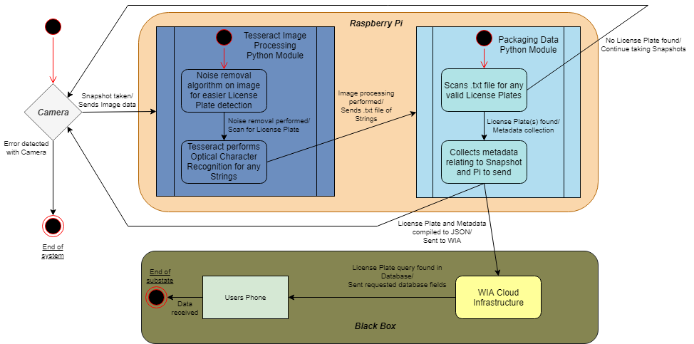
Statechart of Camera / Raspberry Pi Interaction
In-depth look of Image Processing and Packaging Data in Raspberry Pi.
Treats the different devices as different states (e.g. Camera, Raspberry Pi).
Note that the Pi loops back to the Camera the same time as it proceeds to the “Black Box”.

Slide 5
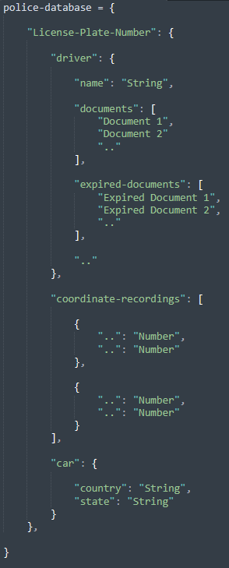
Document Object Model of Police System’s Database
This Police System is one example of an Application that listens to the Message Broker that can be implemented.
DOM shows what the structure of the database and what can be accessed and stored.
Note that this DOM follows the JSON notation.
Notes:
Original purpose of project was to use ALPR for Police, now used and implemented as an example as a subscriber to the Message Broker.
Database has driver name, documents, etc.
Optionally the most recent coordinates of the snapshots found can be recorded..

Slide 6
Any Questions?

